Slide 1


Slide 2

License Plate recognition
LPR (License Plate Recognition) is an image-processing technology used to identify vehicles by their license plates. This technology is used in various security and traffic applications, such as the access-control system featured in the following animation.

Slide 3
Canny edge detection
Canny edge detection is a popular image processing technique used to find edges in images. It works by detecting areas of rapid intensity change, which often correspond to the boundaries of objects in a scene.
For eg:-
Imagine you have a black-and-white picture, and you want to find all the edges in the image (where one object ends and another begins). Canny edge detection helps you do that.
Noise Reduction
Gradient Calculation
Non-maximum Suppression
Thresholding
Edge Tracking by Hysteresis

Slide 4
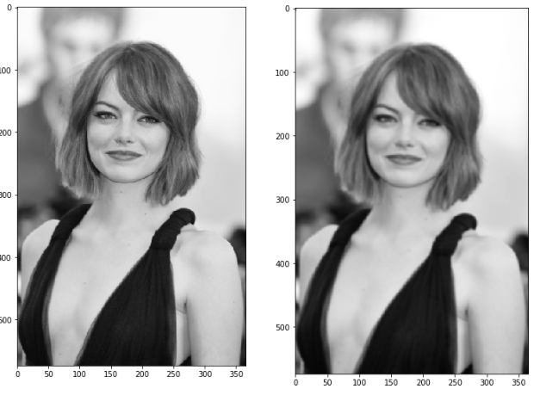
Noise Reduction
Original image (left) — Blurred image with a Gaussian filter (sigma=1.4 and kernel size of 5x5)

Slide 5
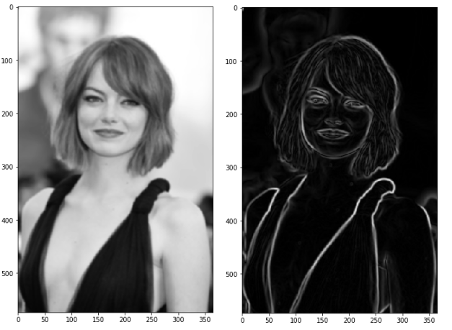
Gradient Calculation
Blurred image (left) — Gradient intensity (right)

Slide 6
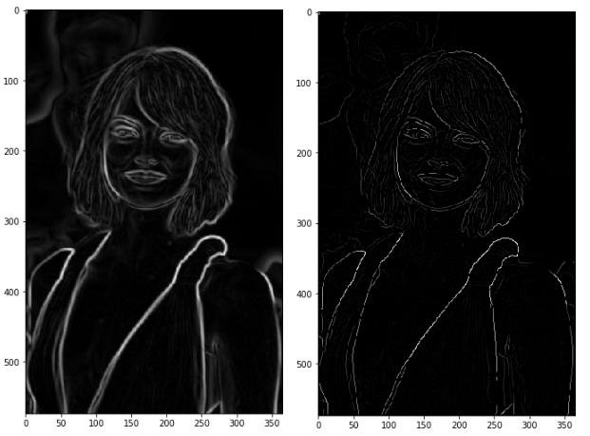
Non-maximum Suppression
Result of the non-max suppression.

Slide 7
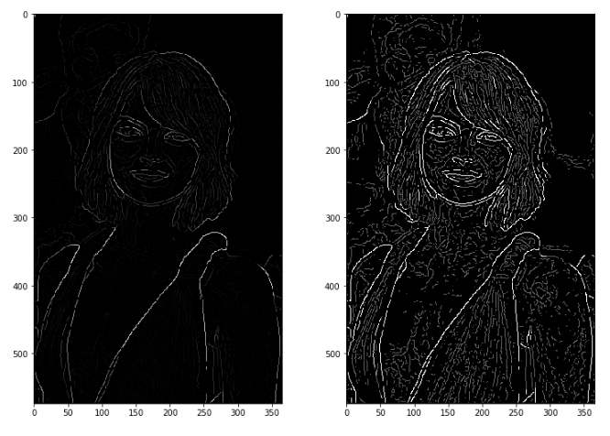
Thresholding
Non-Max Suppression image (left) — Threshold result (right): weak pixels is gray and strong ones in white.

Slide 8
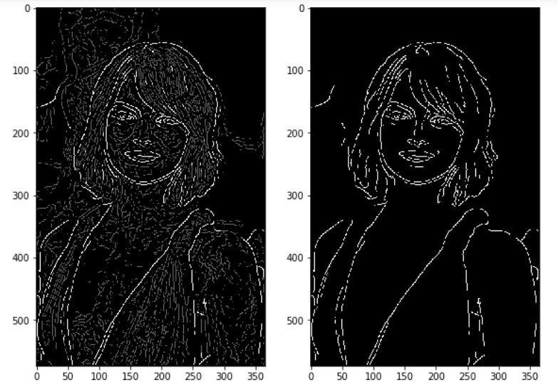
Edge Tracking by Hysteresis
Results of hysteresis process

Slide 9
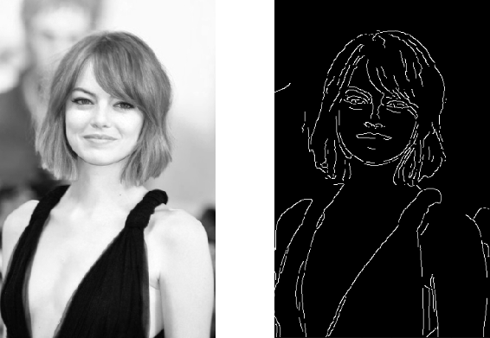
Final

Slide 10
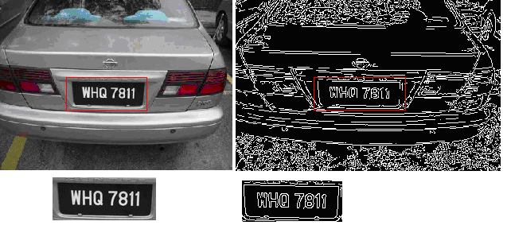
Final

Slide 11
Block Diagram – Workflow
Read the image file
Convert to Grayscale Image
Canny Edge Detection
Find the contour with 4 potential corners and create ROI around it
Removing Noise from the detected image, before sending to Tesseract
Text Recognition
Draw License Plate and write the Text

Slide 12
Ready For Hands On

Slide 13
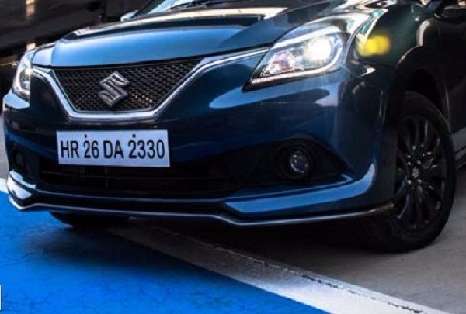
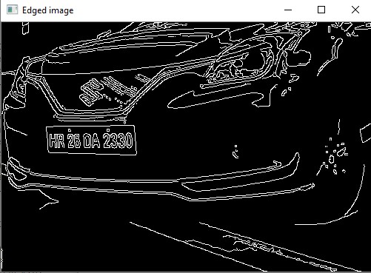
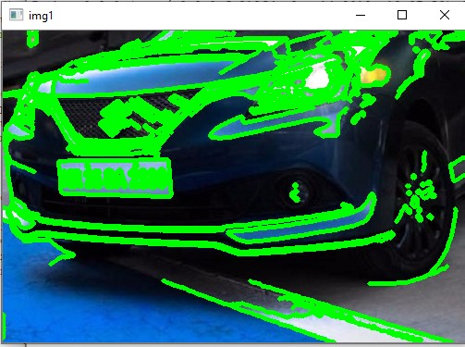
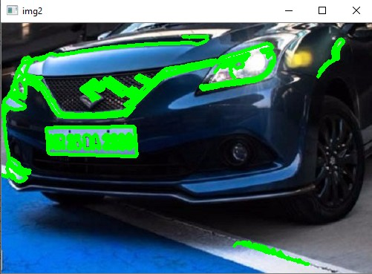

Slide 14




THANK YOU☺
NOVITECH COIMBATORE
novitechresearchanddevelopment

